Slide 1
INTRODUCTION TO CASCADING Introduction to cascading
style sheets
Session 6
(slot 10-11)

Slide 2
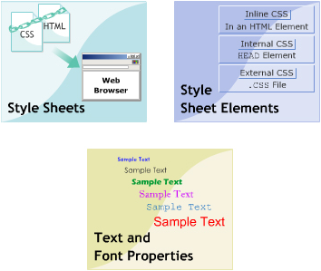
Contents
Style Sheets
Style Sheets Elements
Text and Font Properties

Slide 3
Style Sheets
Explain Cascading Style Sheet
Describe the CSS design goal
Explain the working of CSS

Slide 4
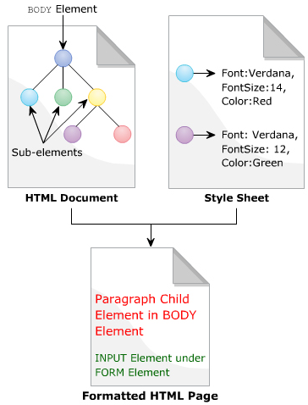
Cascading Style Sheet
A style sheet is a collection of rules that specifies the appearance of data in an HTML document.
Style sheet overcome some properties of html element by specifying the formatting instructions in the separate file.
A Cascading Style Sheet (CSS) is a rule-based language, which specifies the formatting instructions for the content specified in an HTML page.

Slide 5
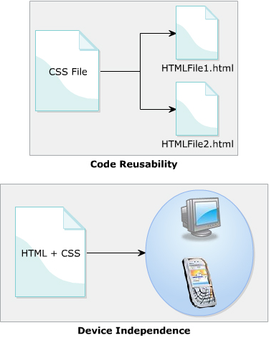
Cascading Style Sheet
Benefit:
  Code reusability.
  Less HTML code.
  Device independence.

Slide 6
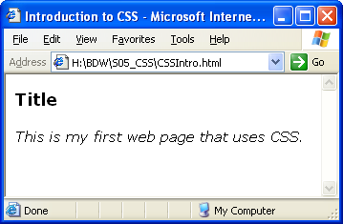
Cascading Style Sheet
<html>
<head>
<title>Introduction to CSS</title>
<style type="text/css" media="screen">
body {
font-family: Verdana;
font-size: 16px;
}
p {
font-style:italic;
}
</style>
</head>
<body>
<H3>Title</H3>
<p>This is my first web page that uses CSS.</p>
</body>
</html>

Slide 7
CSS design goal
The latest version of CSS in use is CSS2. These goals are:
  Compatibility
  Complementary to html
  Independent Functioning
  Maintainability
  Simplify
More design goal:
  Network performance
  Flexibility
  Richness
  Alternative language bindings
  Accessibility.

Slide 8
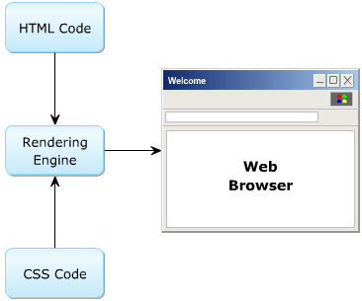
Working of CSS
Inline - using a style attribute in HTML elements
Internal - using a <style> element in the HTML <head> section
External - using one or more external CSS files

Slide 9
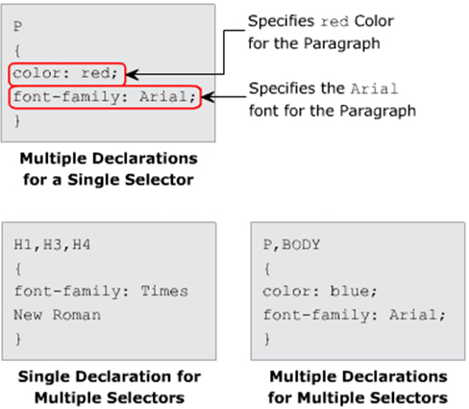
Style Sheets Elements
Syntax:
element { property:value; property:value }

Slide 10
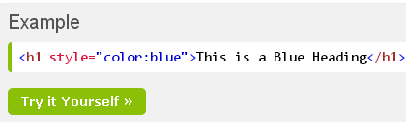
Inline Styling (Inline CSS)

Slide 11
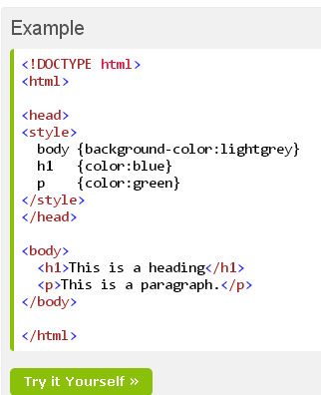
Internal Styling (Internal CSS)

Slide 12
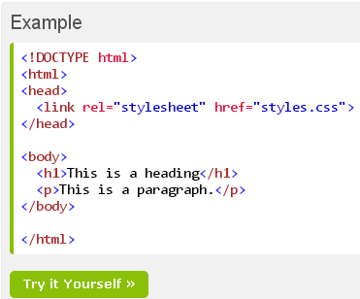
External Styling (External CSS)

Slide 13
Style Sheets Elements: Selector
CSS provides four different types of selectors:
  Type selector
  Class selectors
  ID selectors
  Universal selector

Slide 14
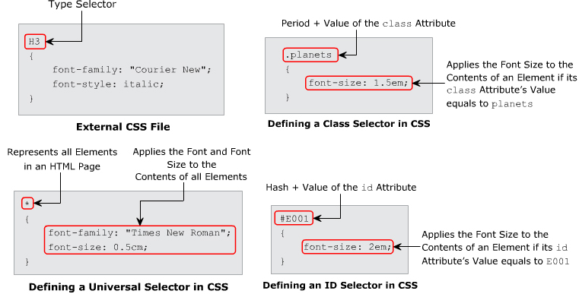
Style Sheets Elements: Selector

Slide 15
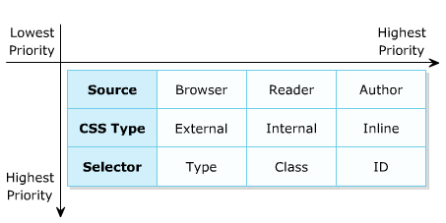
Style Sheets Elements: Selector
Generic cascading order

Slide 16
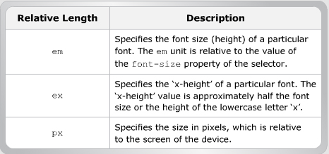
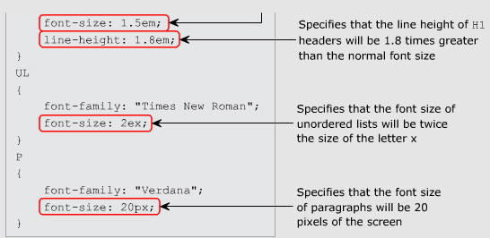
Style Sheets Elements
Length measurement units: Relative

Slide 17
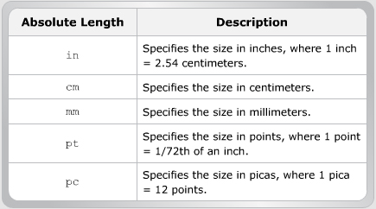
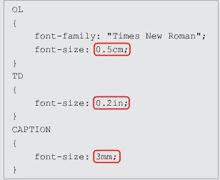
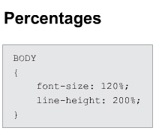
Style Sheets Elements
Length measurement units: Absolute

Slide 18
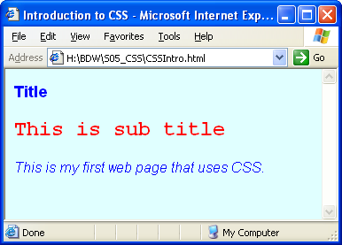
Style Sheets Elements
<html>
<head>
<title>Introduction to CSS</title>
<link rel="stylesheet" type="text/css" href="myCSS.css"/>
<style type="text/css" media="screen">
p {
font-style:italic;
}
</style>
</head>
<body>
<H3>Title</H3>
<h2 style="color:red; font-family:'Courier New';">
This is sub title</h2>
<p>This is my first web page that uses CSS.</p>
</body>
</html>

Slide 19
Text and Font Properties
Explain the text properties.
Explain the font properties.

Slide 20
Text Properties
Property | Description | Value
color | Specifies the color of text. | red, green, #FFAA00, …
text-align | Specifies the alignment of text in an element. | left, right, center, justify.
text-decoration | Specifies the alignment of text in an element. | none, underline, overline, line-through.
text-indent | Specifies the indentation of first line of text. | length, %.
text-transform | Specifies the casing of text. | none, capitalize, uppercase, lowercase.
word-spacing | sets the word spacing for text content | normal, length.
Notes:
TEXT-INDENT: lùi đầu vòng
WORD-SPACING: khoảng cách giữa các chữ
PADDING: lề từ đường biên tới nội dung bên trong
img{float:left}: tấm ảnh sẽ nổi lên bên trái, nhường không gian bên phải cho những thành phần bên dưới (trong css)
MARGIN: lề của đối tượng so với nội dung xung quanh bên ngoài

Slide 21
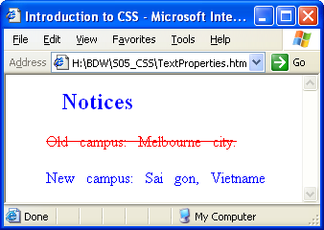
Text Properties
div { color: blue;
text-align: left;
text-indent: 2em;
word-spacing: 2mm;
}
.old { color: gray;
text-decoration: line-through;
}
<html>
<head>
<title>Introduction to CSS</title>
<link rel="stylesheet" type="text/css" href="myCSS2.css">
</head>
<body>
<div>
<h2>Notices</h2>
<p class="old">Old campus: Melbourne city.</p>
<p>New campus: Sai gon, Vietname</p>
</div>
</body>
</html>

Slide 22
Font Properties
Property | Description | Value
font-family | Specifies the font. | Arial, Helvetica, sans-serif,…
font-size | Specifies the size of font. | medium, xx-small, 12px, x-large,…
font-style | Specifies the size of font. | italic, oblique, normal, inherit
font-variant | Specifies the size of font. | inherit, normal, small-caps

Slide 23
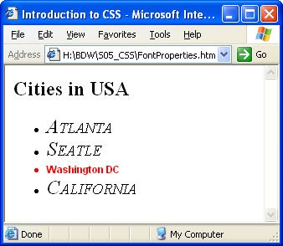
font Properties
UL{ font-family: "Times New Roman";
font-size: large;
font-style: italic;
font-variant: small-caps;
}
#shorthand{
font:bold 12px Arial;
color:red;
}
<html>
<head>
<title>Introduction to CSS</title>
<link rel="stylesheet" type="text/css" href="myCSS3.css">
</head>
<body>
<div>
<h2>Cities in USA</h2>
<ul>
<li>Atlanta</li>
<li>Seatle</li>
<li id="shorthand">Washington DC</li>
<li>California</li>
</ul>
</body>
</html>

Slide 24
Summary
A style sheet is a collection of rules that specifies the appearance of data in an HTML document.
A Cascading Style Sheet (CSS) is a rule-based language, which specifies the formatting instructions for the content specified in an HTML page.
You can embed the CSS code within the HTML code or link the HTML file to the CSS file.

Slide 25
Summary …
There are three types style sheets: inline, internal and external.
Can apply style from multiple style sheets to HTML elements
The Text properties specify and control the appearance of the text in the Web page.
The Font properties allow to specify the font for the text.
Notes:
(*) Để khai báo một luật css, áp dụng cho đối tượng có khai báo là ID thì tên của luật đó phải bắt đầu bằng dấu #
(*) Một CSS dạng class sẽ được áp dụng cho nhiều đối tượng khác nhau. Để tạo một luật dạng class, thì tên của luật đó phải bắt đầu bằng dấu ‘.’

Slide 26
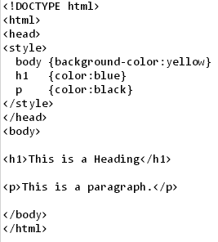
Exercise 1

Slide 27
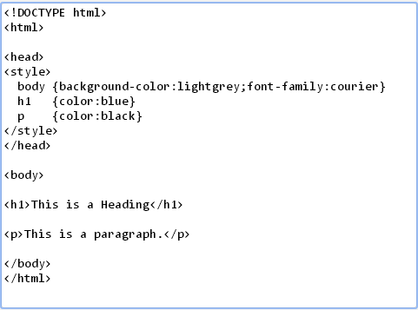
Exercise 2

Slide 28
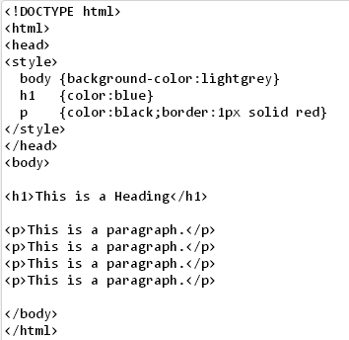
Exercise 3

Slide 29
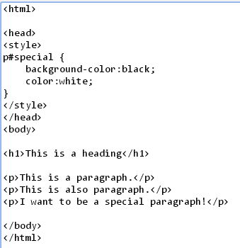
Exercise 4

Slide 30
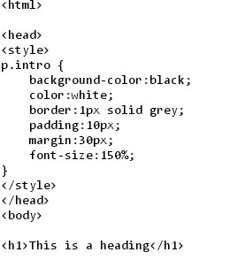
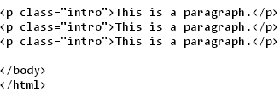
Exercise 5

